Slide 1


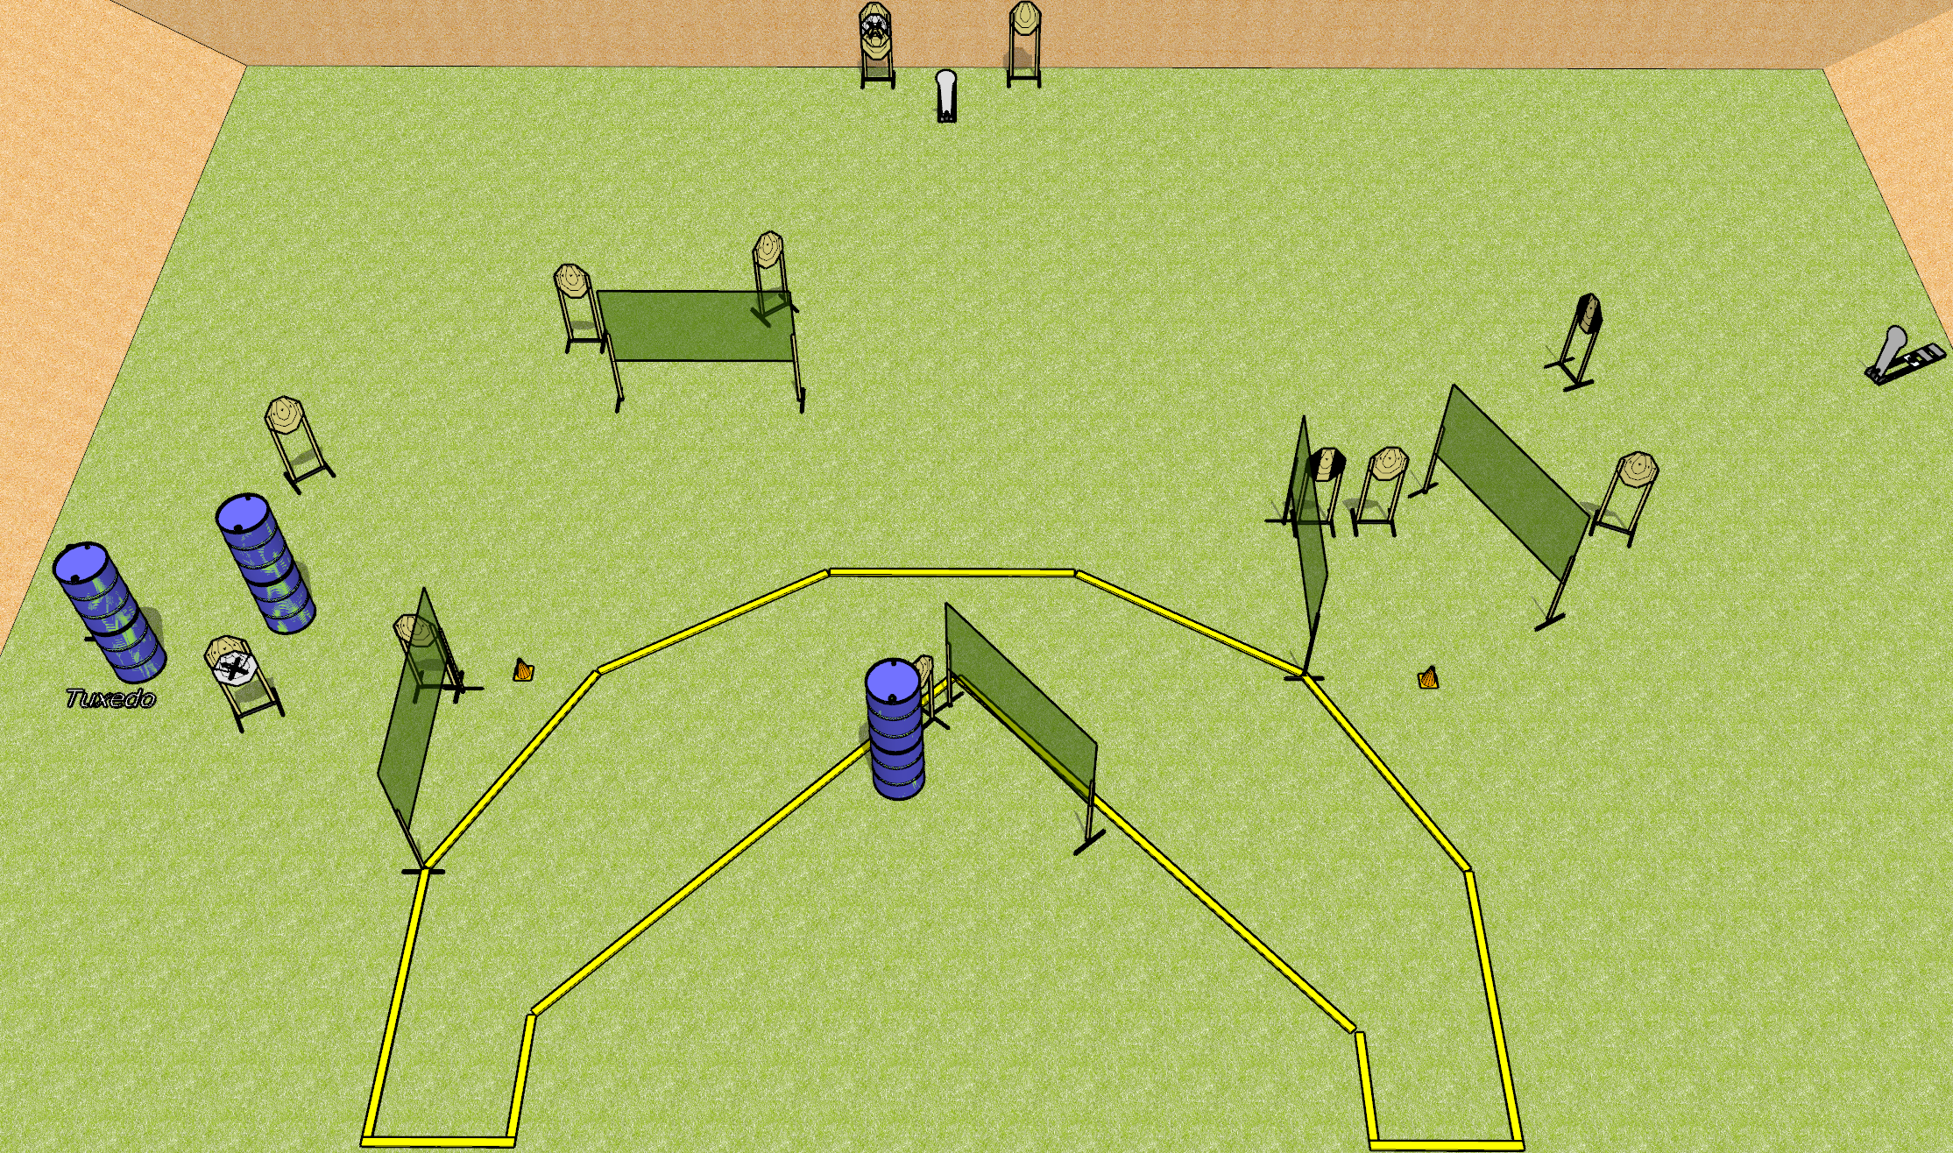
 | Dothan Gun Club – USPSA Match Some Kind of Shoe Course Designer : Drew Coleman
Round Count 30 rounds 14 IPSC 2 colt poppers
Equipment List 10 wall feet 4 medium fault lines 3 hard cover of some kind

Slide 2
Some Kind of Shoe
Written Stage Briefing
Some Kind of Shoe is a 30 round, 150 point, Comstock course of fire. There are 14 IPSC targets and 2 colt poppers. The best 2 hits on paper will score, and steel must fall to score. The start signal is audible.
Handgun start position is heels against either rear fault line, wrists below belt. Handgun is loaded and holstered.
PCC start position is heels against either rear fault line, muzzle pointed at either cone. Loaded carbine is held with both hands, shouldered, safety on.
On start signal engage targets as they become available from within the shooting area.

